Slide 1
APOLOGETICS
IN ONE LESSON
almost
Ai1L.net
Lesson 9
How Not to Start a Religion

Slide 2
Key Takeaways (review)
1
Jews had sophisticated teaching methods designed to improve memorization
2
The New Testament is best understood within a Jewish context
3
Jesus used many Jewish teaching methods:
Object lessons
Parables
Chiastic structures

Slide 3
IDEA IN BRIEF
What?
Discuss the distinctive attributes of Christianity (such that it got it criticism from the culture)
Why?
To show that a naturalistic explanation of the church’s growth is insufficient, and that Jesus’ resurrection is the best explanation
How?
By showing the church was counter-cultural:
Treatment of women (especially as sources)
Belief in exclusive worship of Jesus as God
Belief in Jesus despite the shame of crucifixion

Slide 4
Detail how crucifixion was viewed by Jews and Gentiles in the first century
1

Slide 5
“They say that our madness consists in the fact that we put a crucified man in second place after the unchangeable and eternal God”
Justin Martyr (150 A.D.) Apology, 13:4

Slide 6
“our pictures of the savage death of Jesus are the product of religious imagination and idealization. In reality, he must have been ghastly to behold.”
THE NEW YORKER
The woman behind the camera at Abu Ghraib
By Philip Gourevitch and Errol Morris March 17, 2008

Slide 7
“the mocking and jeering that accompanied crucifixion were not only allowed, they were part of the spectacle”
FLEMING RUTLEDGE The Crucifixion (page 92)

Slide 8
“﻿on your own showing, your Logos is not a pure and holy Logos, but a man most shameful who was crucified.”
CELSUS
The Fragments of Celsus (page 8)

Slide 9
In what ways did the Gospel differ from the expectations and traditions within the first century?
2

Slide 10
“﻿﻿all men ought to live according to the customs of their country, and are not to be blamed for so doing.”
CELSUS
The Fragments of Celsus (page 26)

Slide 11
“﻿﻿they prove that they have only the will and the power to win over the foolish, the ignoble, slaves, women, and children.”
CELSUS
The Fragments of Celsus (page 15)

Slide 12

“2/3 of the Christianity community during the second-century was made up of women.”
RODNEY W. STARK Sociology of Religion, Volume 56, Issue 3, Fall 1995, Pages 229–244

Slide 13
“This is the exact opposite of the ratio in the broader Greco-Roman world where women only made up about 1/3 of the population.”
RODNEY W. STARK Sociology of Religion, Volume 56, Issue 3, Fall 1995, Pages 229–244

Slide 14
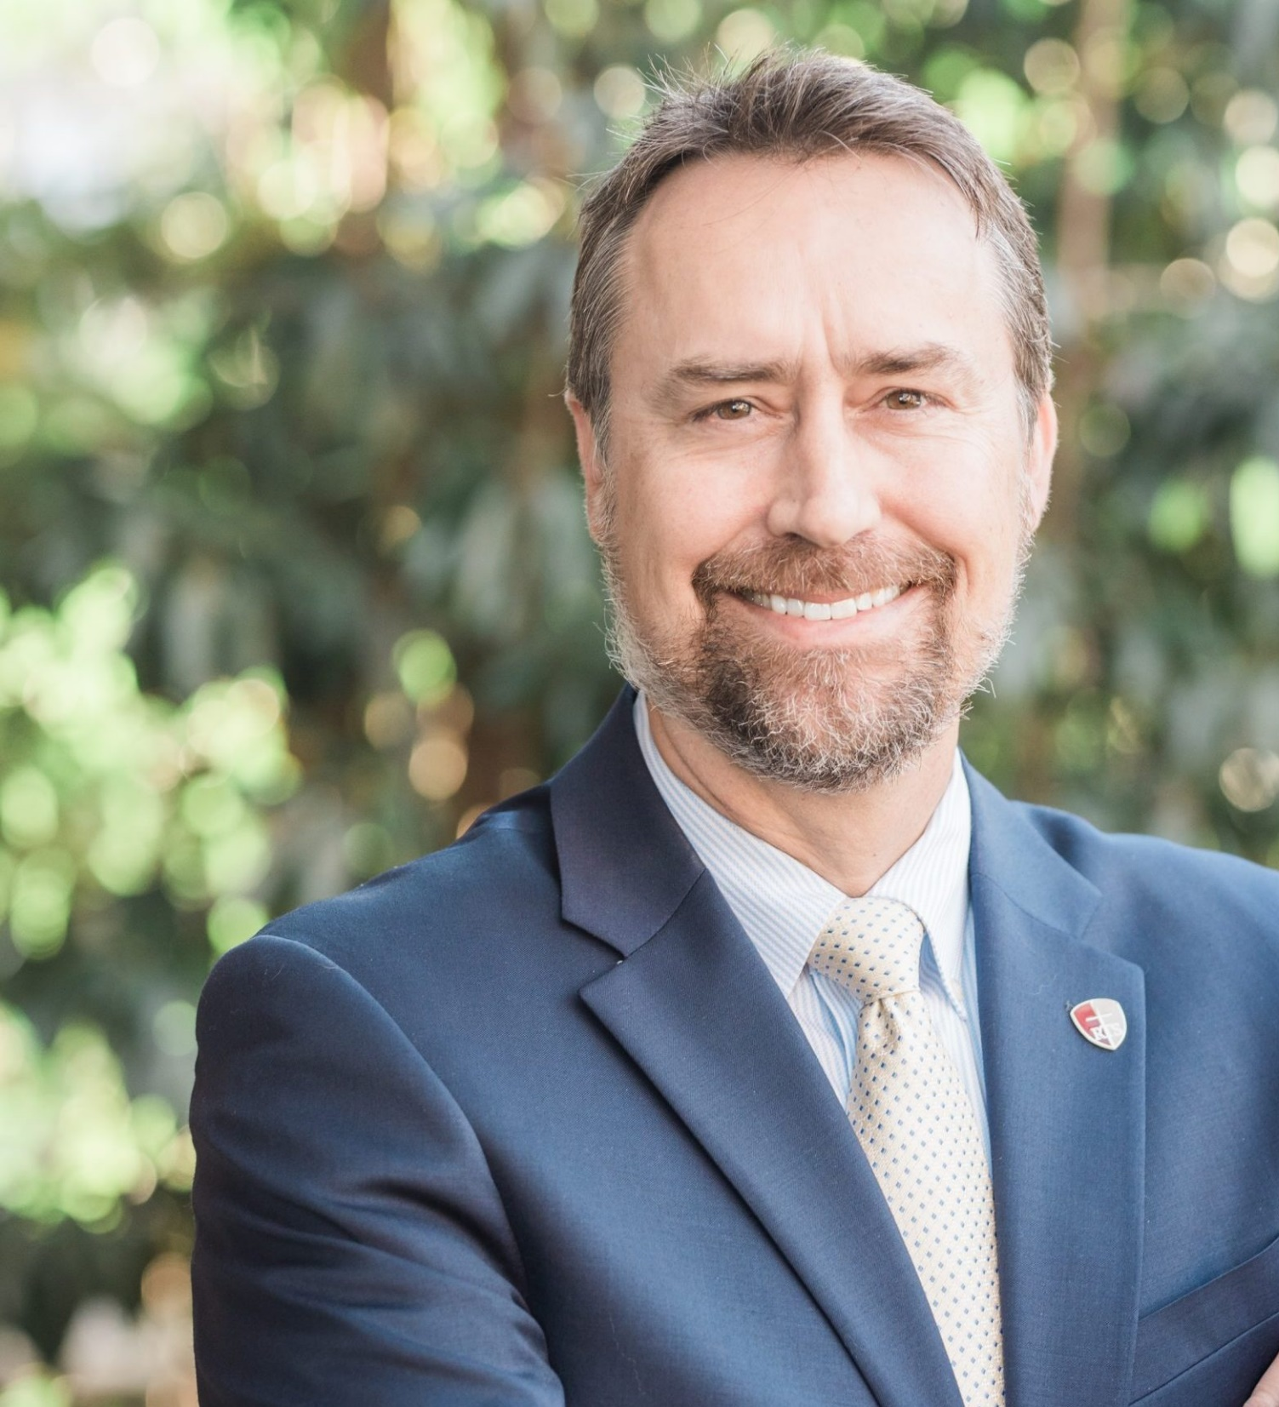
“In short, if early Christianity was a bad place for women, then apparently all the women who joined the movement never got the memo.”
MICHAEL J. KRUGER How Early Christianity was Mocked for Welcoming Women

Slide 15
“I commend to you our sister Phoebe, a servant of the church in Cenchrea. Welcome her in the Lord in a manner worthy of the saints, and assist her with anything she may need from you. For she has been a great help to many people, including me. Greet Prisca and Aquila, my fellow workers in Christ Jesus, who have risked their lives for me. Not only I but all the churches of the Gentiles are grateful to them. Greet also the church that meets at their house. Greet my beloved Epenetus, who was the first convert to Christ in the province of Asia. Greet Mary, who has worked very hard for you. Greet Andronicus and Junia, my fellow countrymen and fellow prisoners. They are outstanding among the apostles, and they were in Christ before I was. Greet Ampliatus, my beloved in the Lord. Greet Urbanus, our fellow worker in Christ, and my beloved Stachys. Greet Apelles, who is approved in Christ. Greet those who belong to the household of Aristobulus. Greet Herodion, my fellow countryman. Greet those from the household of Narcissus who are in the Lord. Greet Tryphena and Tryphosa, women who have worked hard in the Lord. Greet my beloved Persis, who has worked very hard in the Lord. Greet Rufus, chosen in the Lord, and his mother, who has been a mother to me as well. Greet Asyncritus, Phlegon, Hermes, Patrobas, Hermas, and the brothers with them. Greet Philologus and Julia, Nereus and his sister, and Olympas and all the saints with them.”
Romans 16:1-15

Slide 16
“denying the Greek gods and by worshipping the crucified sophist himself and living under his laws”
LUCIAN OF SAMISOTA ﻿The Passing of Peregrinus, 47

Slide 17
Document critics’ responses to the church that made it difficult for Christians
3

Slide 18
What do these say about how women were viewed in the first century?
4

Slide 19
“But their words seemed like nonsense to them, and they did not believe the women”
Luke 24:11

Slide 20
“And these are they which are not qualified [to be witnesses or judges]: A dice player, a usurer, pigeon racers, or traffickers in Seventh Year produce, and slaves. This is the general rule: any testimony for which a woman is not qualified, they too are not qualified.”
Mishnah Rosh Hashanah 1:8

Slide 21
“But let not a single witness be credited, but three, or two at the least, and those such whose testimony is confirmed by their good lives.”
FLAVIUS JOSEPHUS Antiquities of the Jews, 4.8.15

Slide 22
“But let not the testimony of women be admitted, on account of the levity and boldness of their sex”
FLAVIUS JOSEPHUS Antiquities of the Jews, 4.8.15

Slide 23
What other kind of things would have made the Gospel at the time?
5

Slide 24
“Christian Apologists had to argue for their lives.”
LARRY HURTADO Destroyer of the gods (page 2)

Slide 25
Key Takeaways
1
The Gospel was radically counter-cultural in the first century:
Treatment of women (especially as sources)
Belief in exclusive worship of Jesus as God
Belief in Jesus despite the shame of crucifixion
2
The church faced immediate & serious persecution:
Jewish leadership (where the church began)
Roman empire (the superpower of the day)
3
Jesus’ resurrection is the best explanation for the radical growth of the church

